Slide 1
Investigating cluster markers in combined HCC and NSCLC single-cell RNA-Seq data
Miko Liu
6.11.2019

Slide 2
Motivation
Systematic interrogation of tumor-infiltrating lymphocytes is key to the development of immunotherapies and the prediction of their clinical responses in cancers.
Deep single-cell RNA-seq on single T cells isolated from tumor, normal tissues, and peripheral blood
Aggregate datasets from more than one study (batch correction) to find interesting markers in T cell subpopulations
Zheng et al 2017

Slide 3
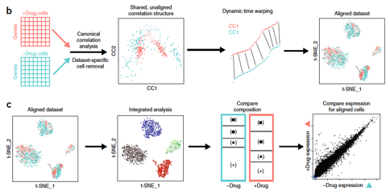
Batch correction method: Seurat
Identify shared correlation structures across data sets, using CCA
Identify the non-overlapping cells
Align datasets into a low-dimensional space, using non-linear warping
Integrated downstream analysis, e.g. identify clusters
Comparative analysis on clusters /aligned subpopulations

Slide 4
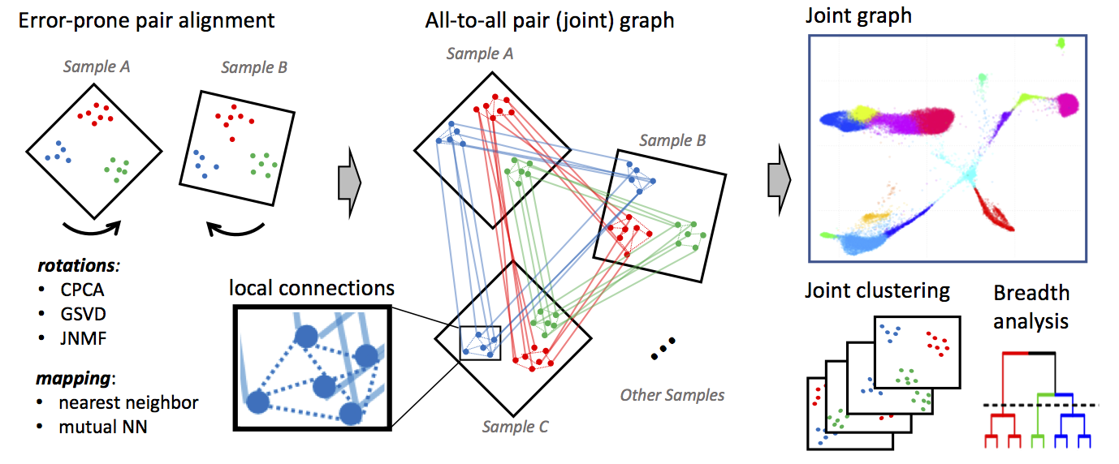
Conos
Conos applies one of many error-prone methods to align each pair of samples in a collection, establishing weighted inter-sample cell-to-cell links, creating a global joint graph.

Slide 5
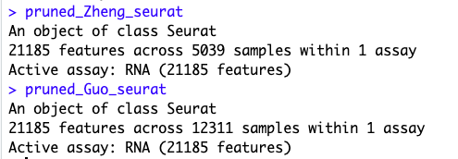
Preprocess each dataset
Load in data
Remove duplicate gene symbols
Remove NA rows
Create Seurat object using the counts
Filter cells (Quality control)
Number of genes detected: 200~7500
Number of molecules detected within a cell: < 2.8M
Normalization
Scaling
Get overlapping genes between the two datasets
For merging seurat objects later
Eventually get: pruned_Zheng_seurat, pruned_Guo_seurat (image above)

Slide 6
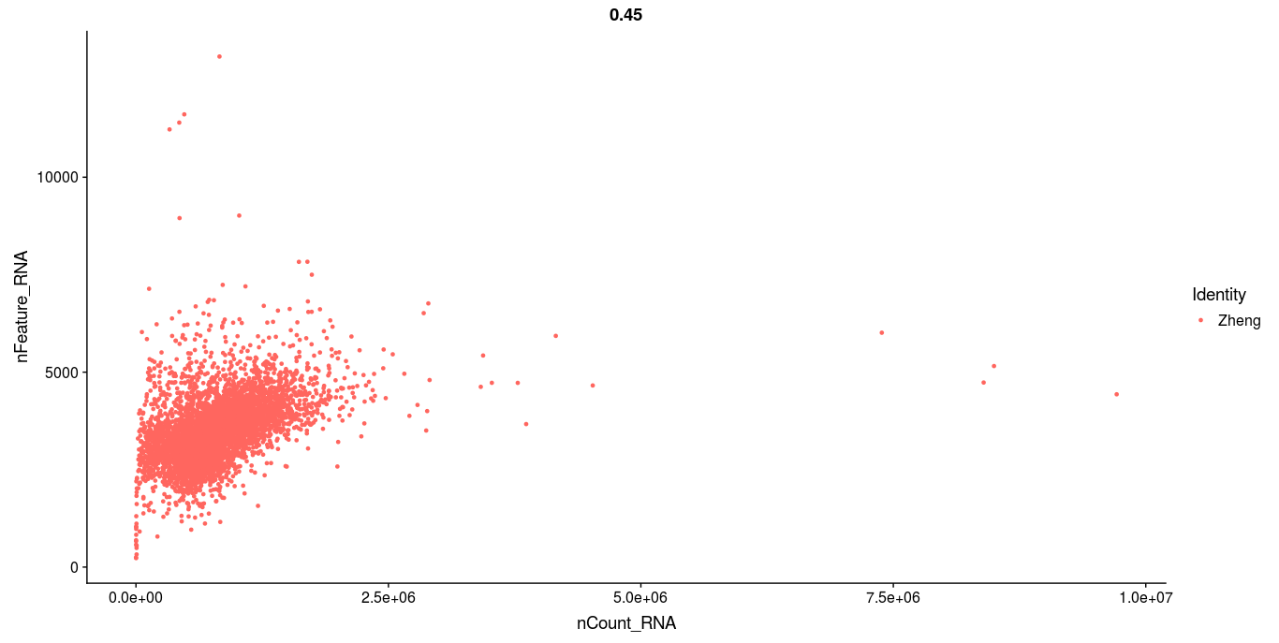
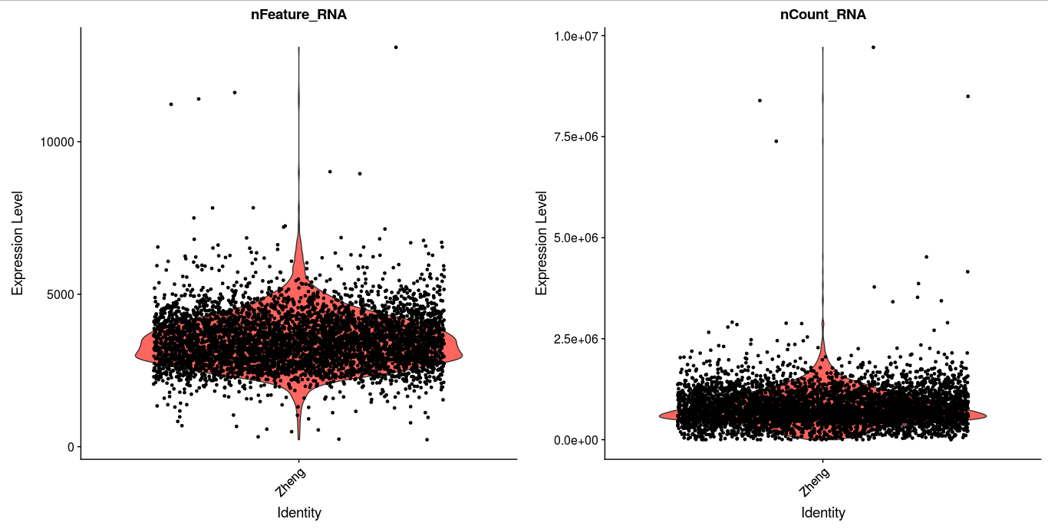
Before filtering: Zheng dataset

Slide 7
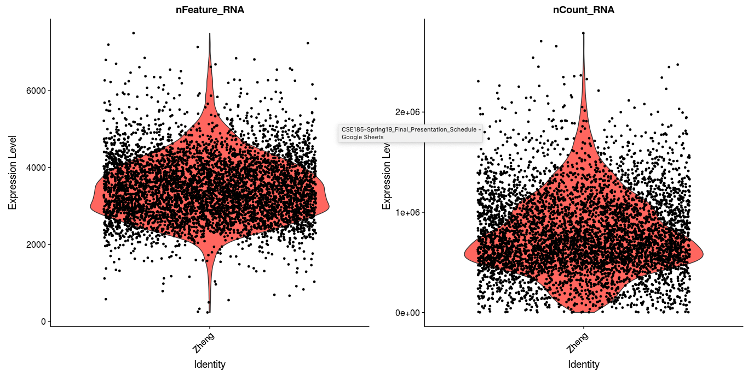
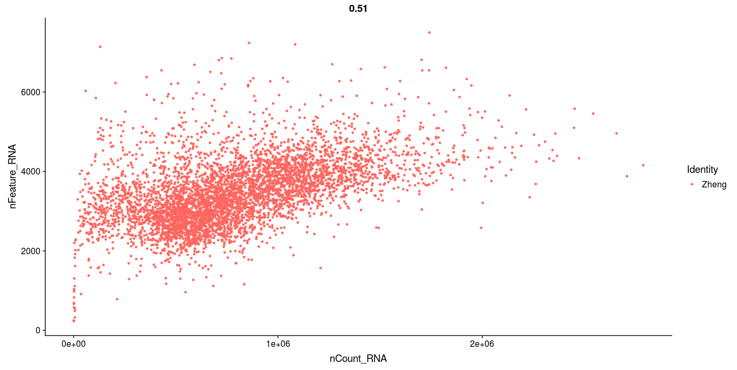
After filtering: Zheng dataset
Number of genes detected: 200~7500
Number of molecules detected within a cell: < 2.8M

Slide 8
Challenges in preprocessing
Keep overlapping genes:
subset genes first
then create a new seurat object
Remove NA when merging the seurat objects

Slide 9
Workflow to visualize clusters
Merge two seurat objects representing two datasets (HCC, NSCLC)
merge(), FindVariableFeatures(), ScaleData()
RunPCA(), RunUMAP(), FindNeighbors(), FindClusters()

Slide 10
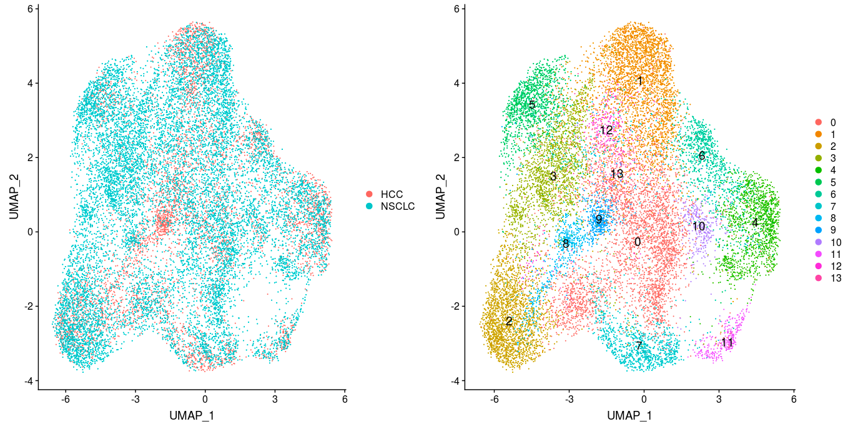
After Seurat batch correction: 14 clusters total
Using FindIntegrationAnchors() and IntegrateData()

Slide 11
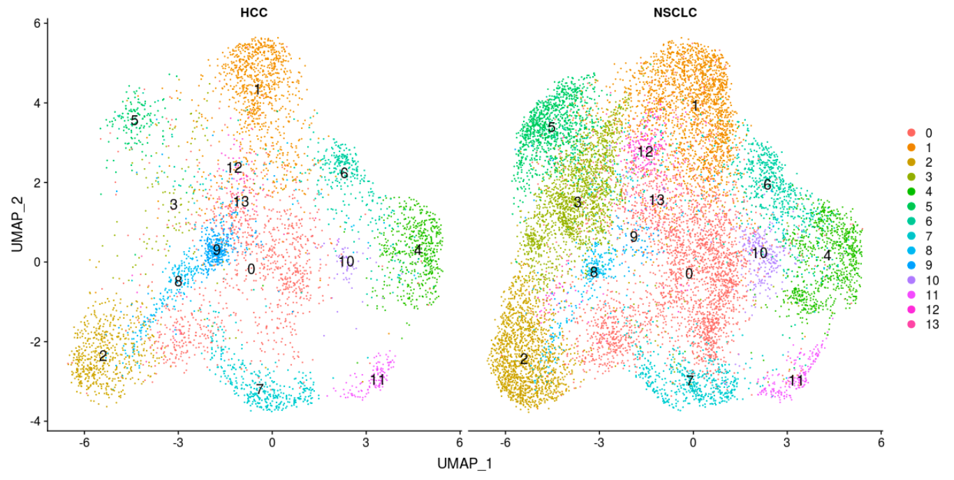

Slide 12
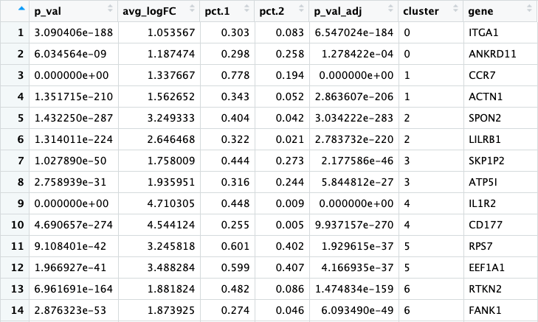
Identify cluster markers
FindAllMarkers()
…...

Slide 13
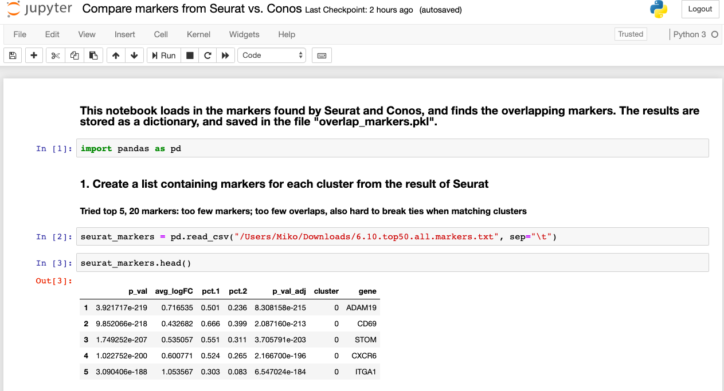
Compare markers found by Seurat and Conos
Found overlapping markers using python, stored in a dictionary

Slide 14
Plotting the top markers found by both methods

Slide 15
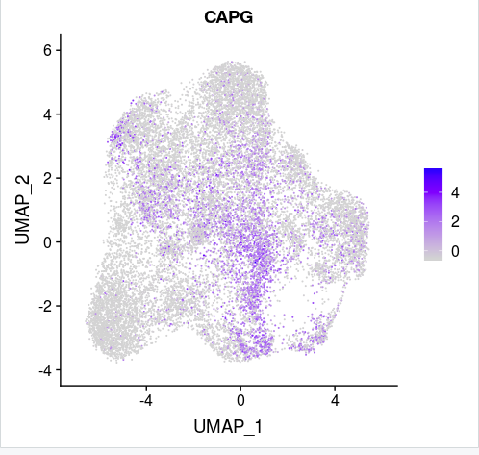
Cluster 0: CAPG
Involved in nuclear transport

Slide 16
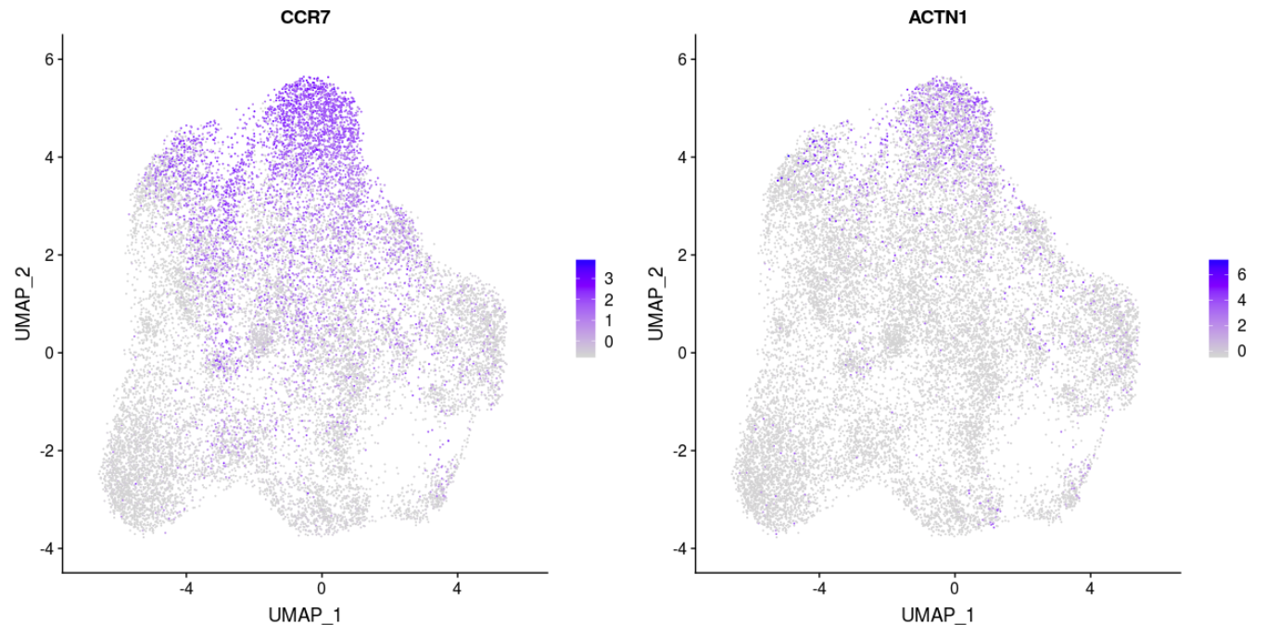
Cluster 1: CCR7, ACTN1
CCR7: A member of GPCR, activates B and T lymphocytes
ACTN1: A cytoskeletal protein

Slide 17
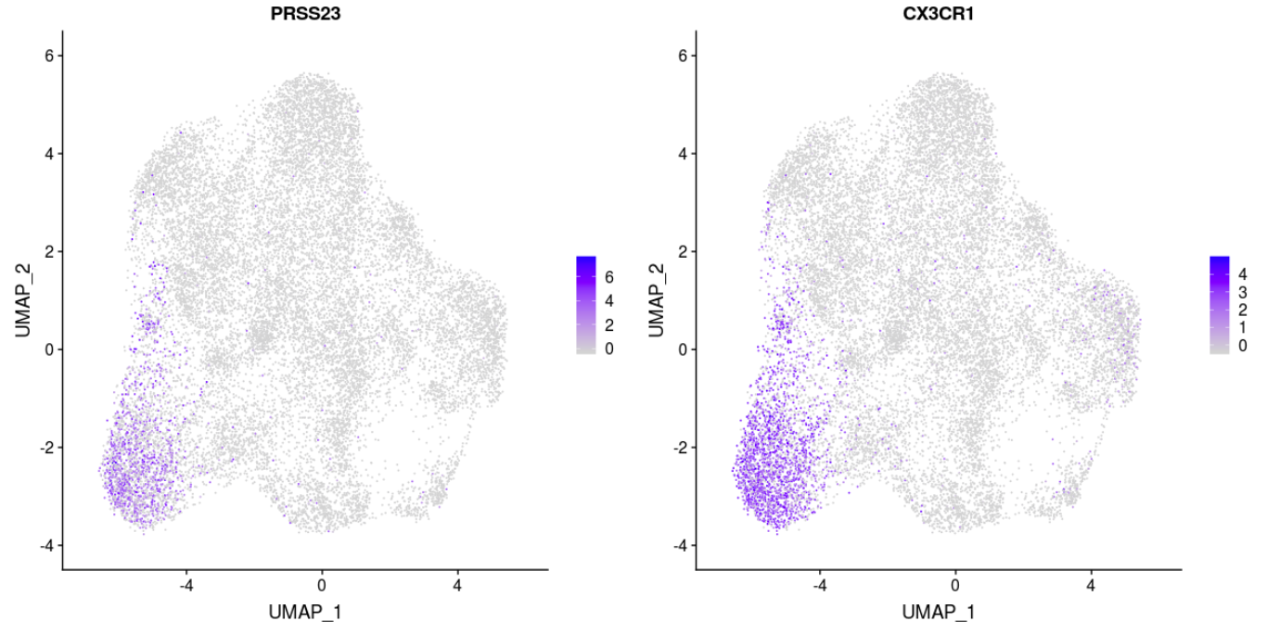
Cluster 2: PRSS23, CX3CR1
PRSS23: trypsin family of serine proteases
CX3CR1: involved in GPCR pathway, coreceptor for HIV-1

Slide 18
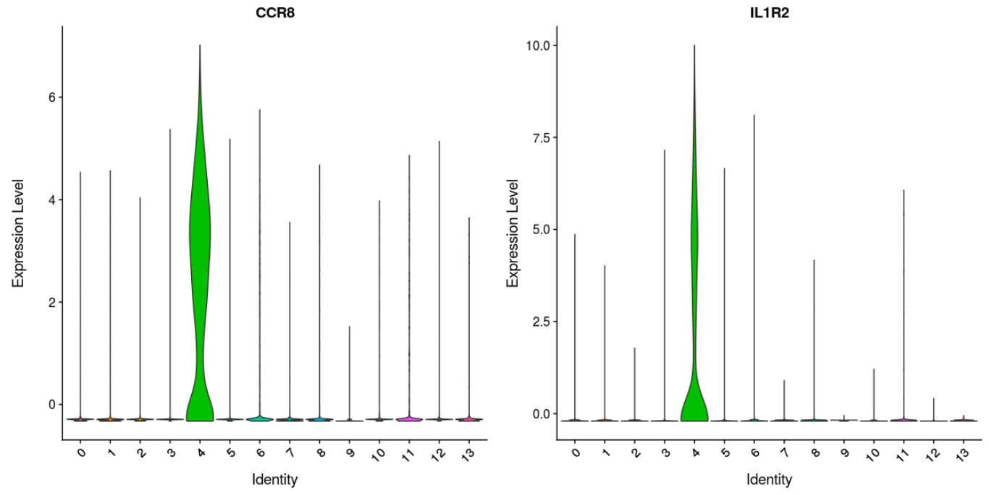
Cluster 4: CCR8, IL1R2

Slide 19
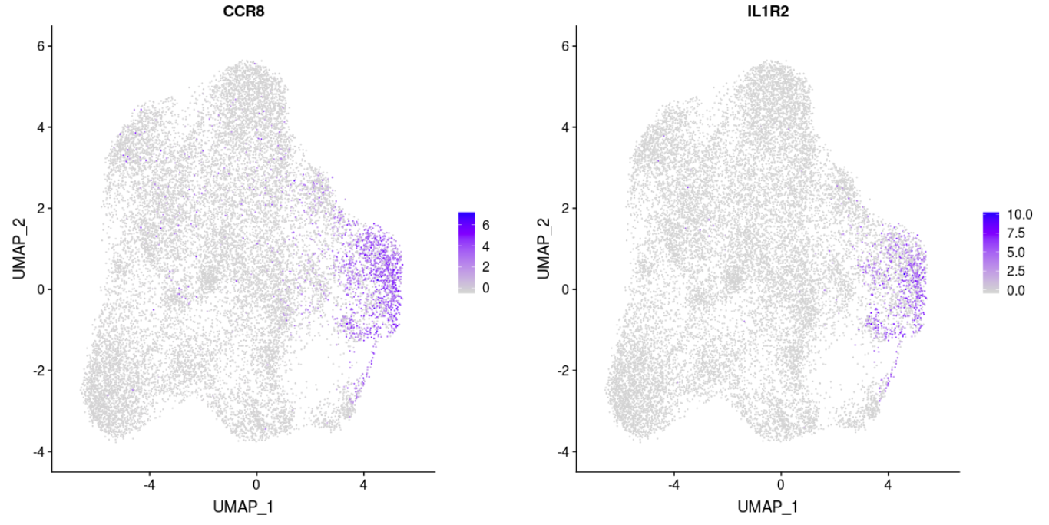
Cluster 4: CCR8, IL1R2
CCR8: important for the migration of various cell types into the inflammatory sites, involved with activated T cells
IL1R2: major mediators of the immune response

Slide 20
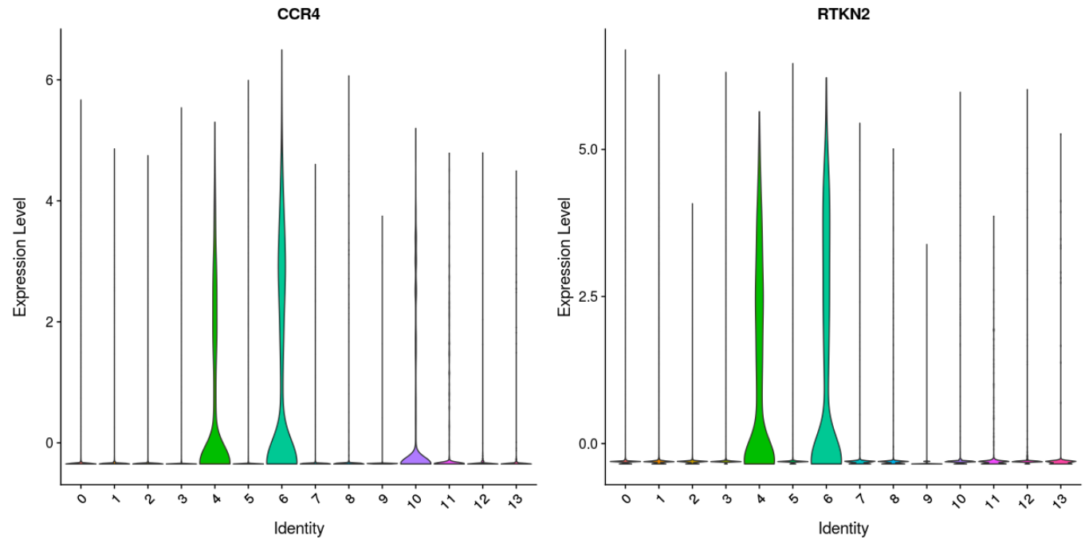
Cluster 6: CCR4, RTKN2

Slide 21
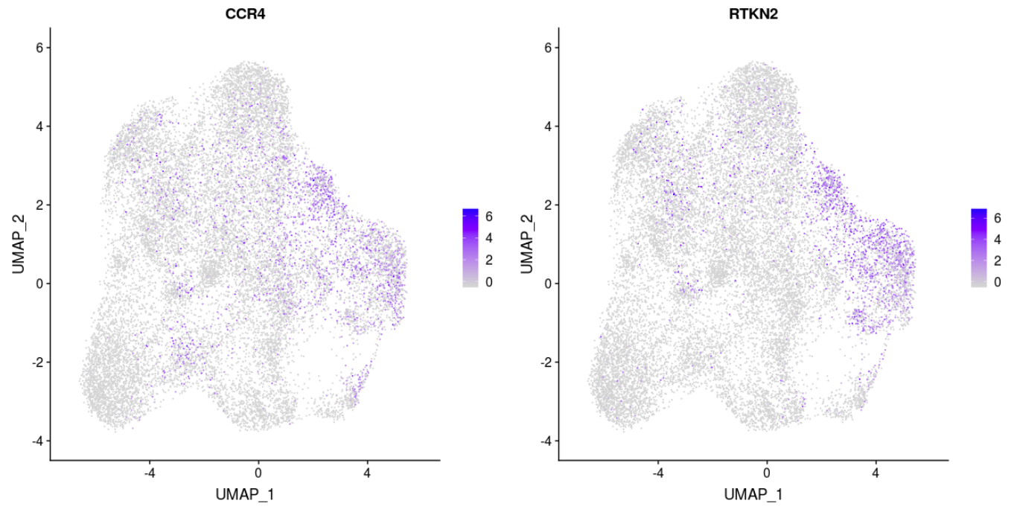
Cluster 6: CCR4, RTKN2
CCR4: A member of GPCR, can function as a chemoattractant homing receptor on circulating memory lymphocytes

Slide 22
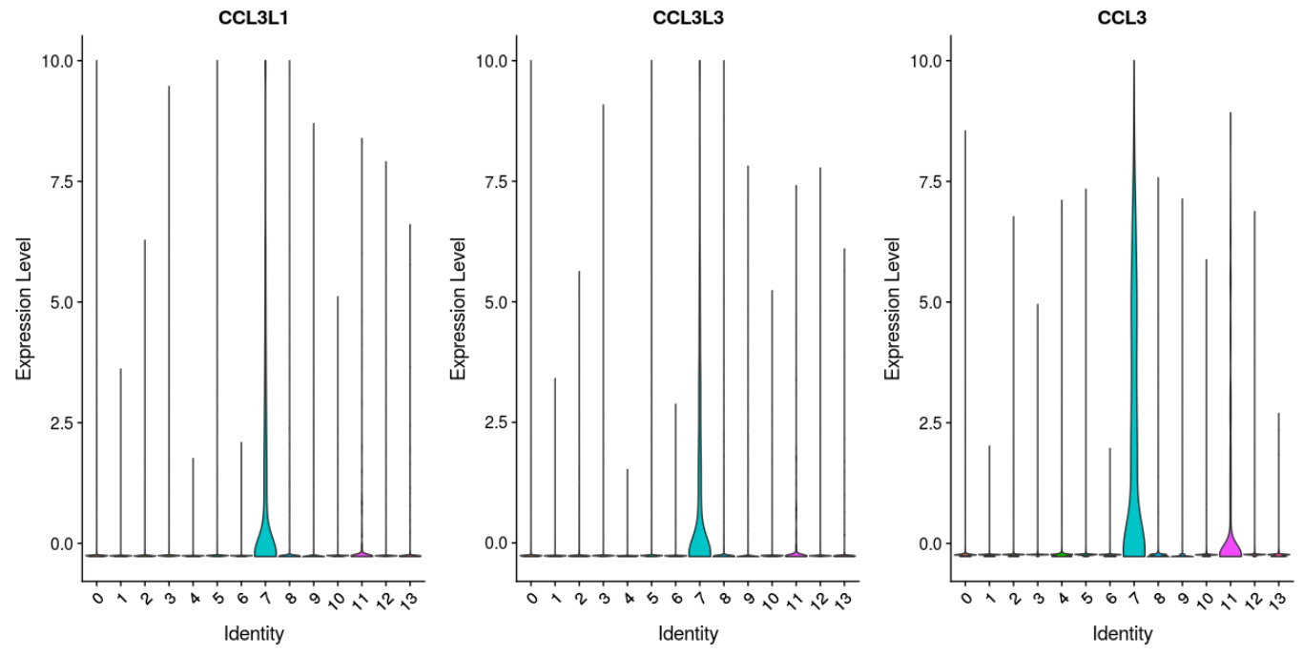
Cluster 7: CCL3L1, CCL3L3, CCL3

Slide 23
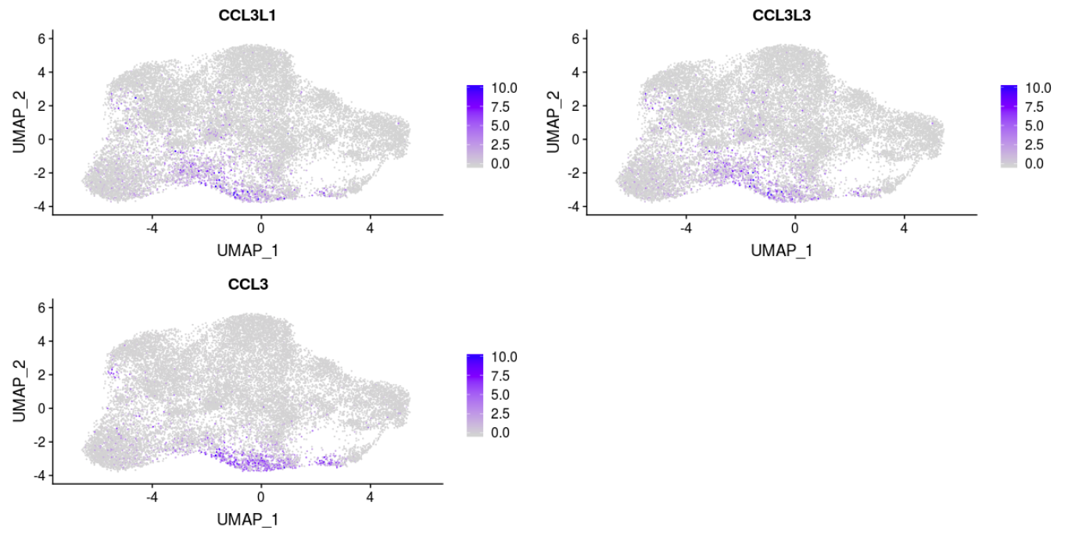
Cluster 7: CCL3L1, CCL3L3, CCL3
CCL3: plays a role in inflammatory responses through binding to the receptors CCR1, CCR4 and CCR5

Slide 24
Plotting the top markers found by Seurat
-- Not overlapping with the top 50 markers found by Conos

Slide 25
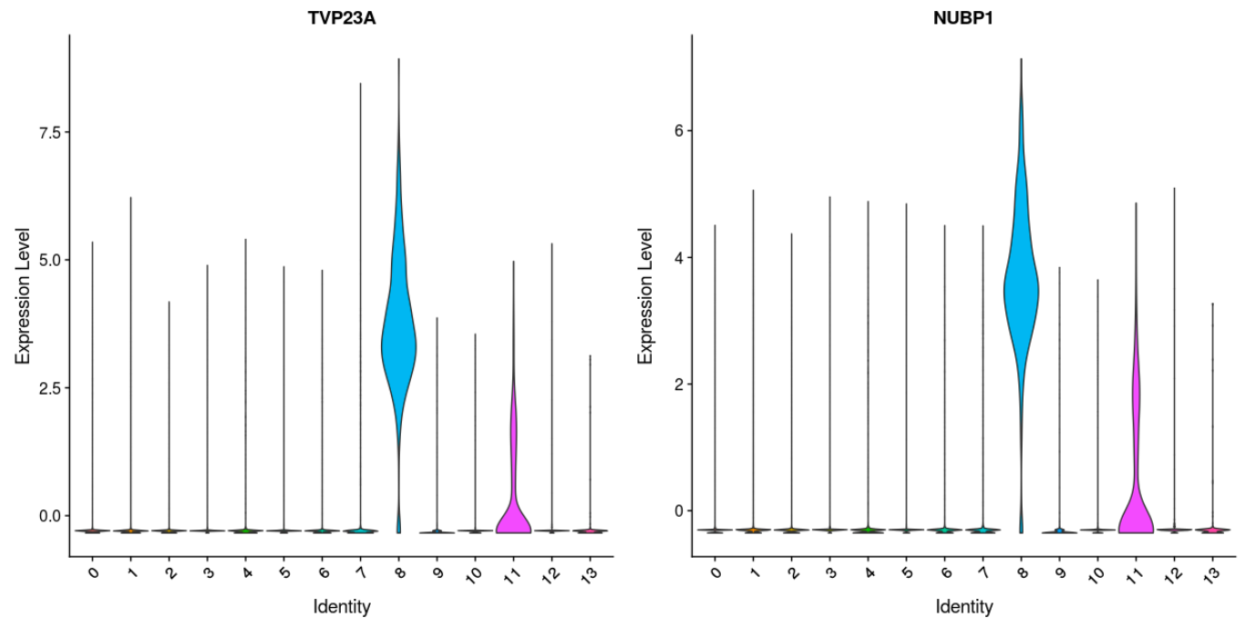
Cluster 8: TVP23A, NUBP1

Slide 26
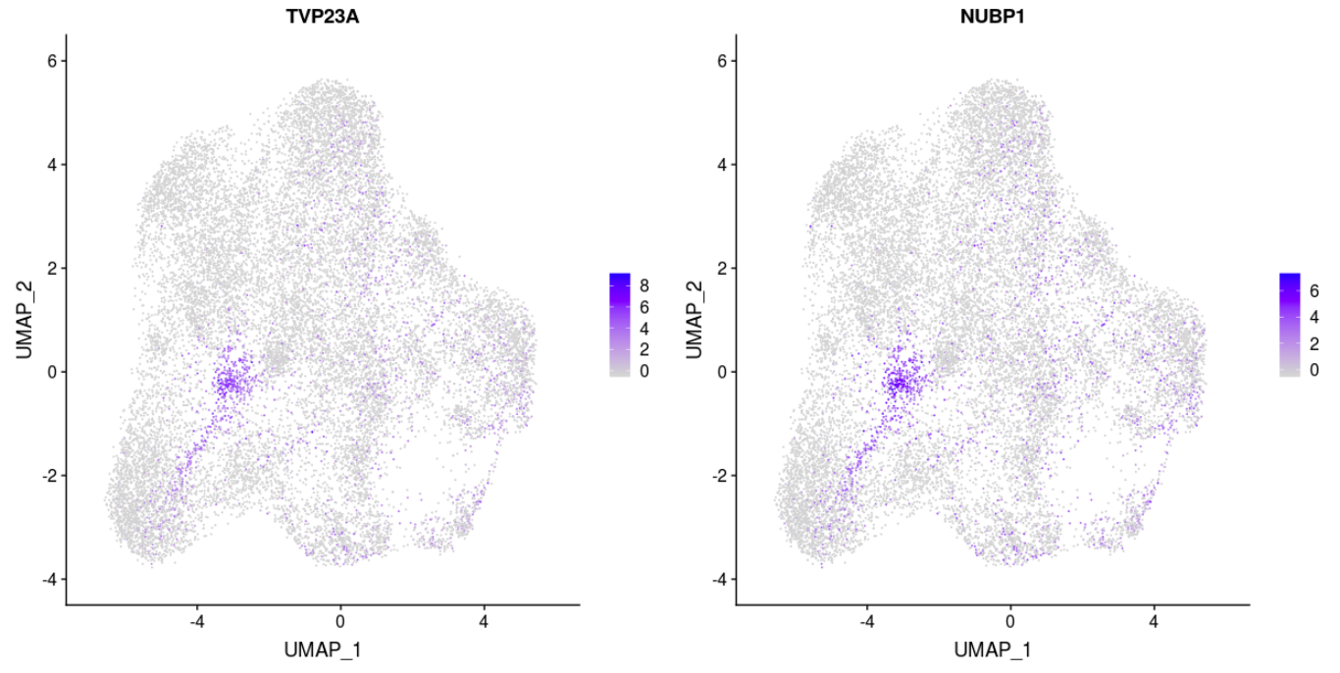
Cluster 8: TVP23A, NUBP1
TVP23A: plays a crucial role in intracellular vesicular transport
NUBP1: Required for maturation of extramitochondrial Fe-S proteins

Slide 27
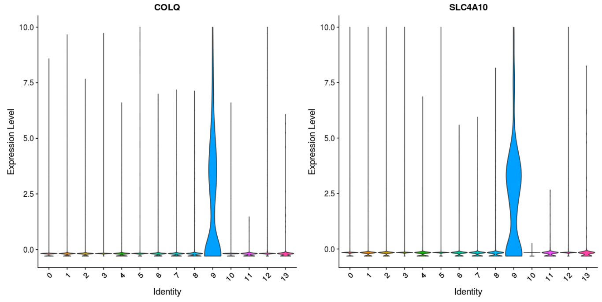
Cluster 9: COLQ, SLC4A10 (more expression in HCC)

Slide 28
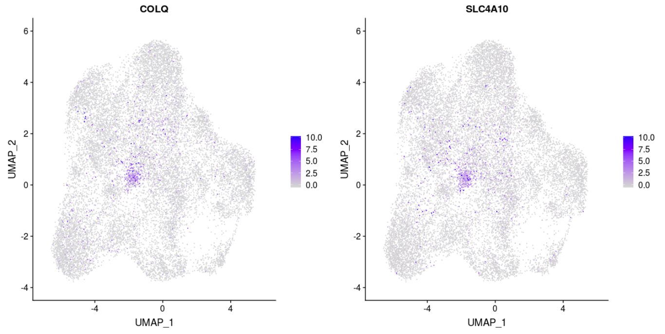
Cluster 9: COLQ, SLC4A10 (more expression in HCC)
COLQ: associated with acetylcholinesterase in skeletal muscle
SLC4A10: a member of the SLC4 family of transmembrane solute carriers

Slide 29
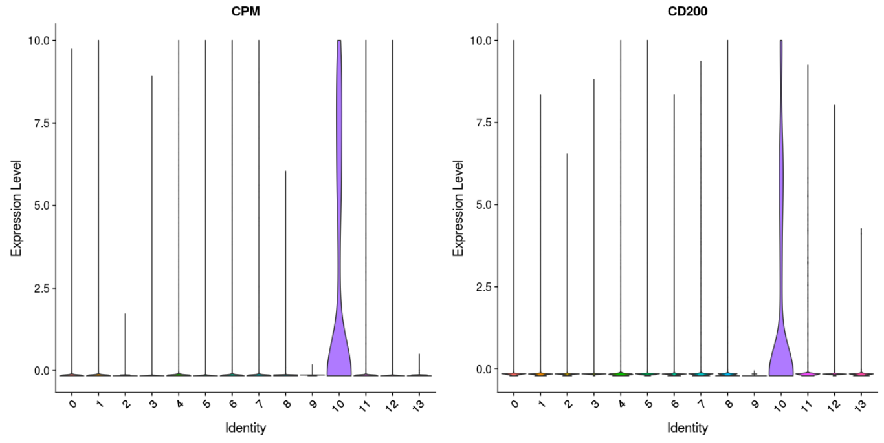
Cluster 10: CPM, CD200

Slide 30
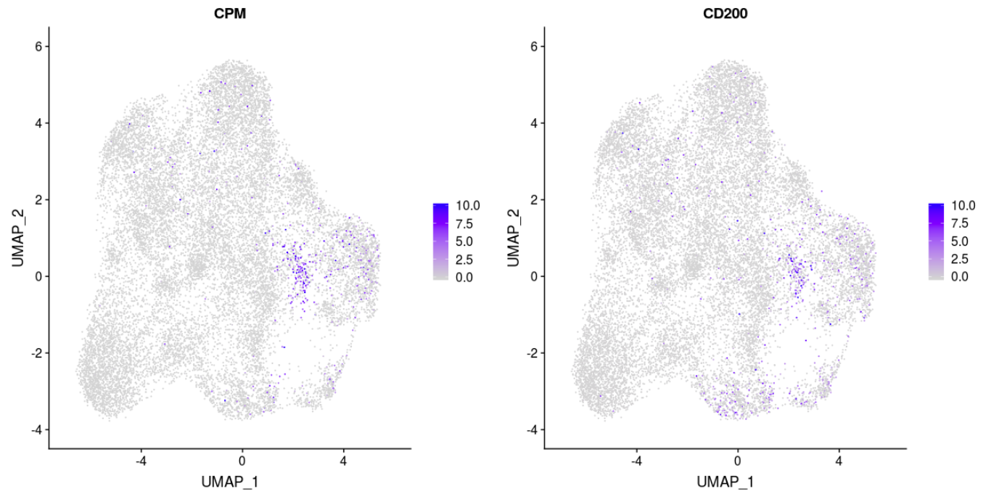
Cluster 10: CPM, CD200
CD200: plays an important role in immunosuppression and regulation of anti-tumor activity

Slide 31
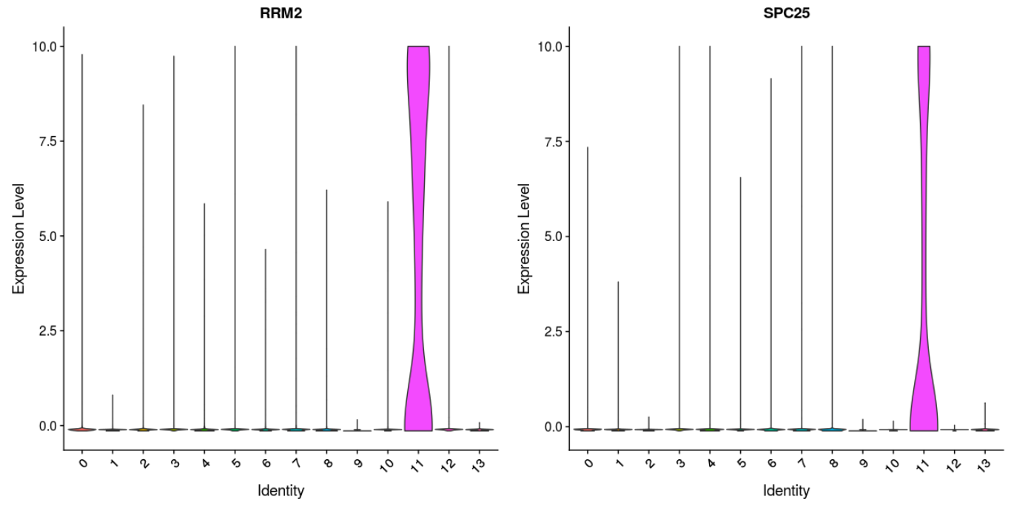
Cluster 11: RRM2, SPC25

Slide 32
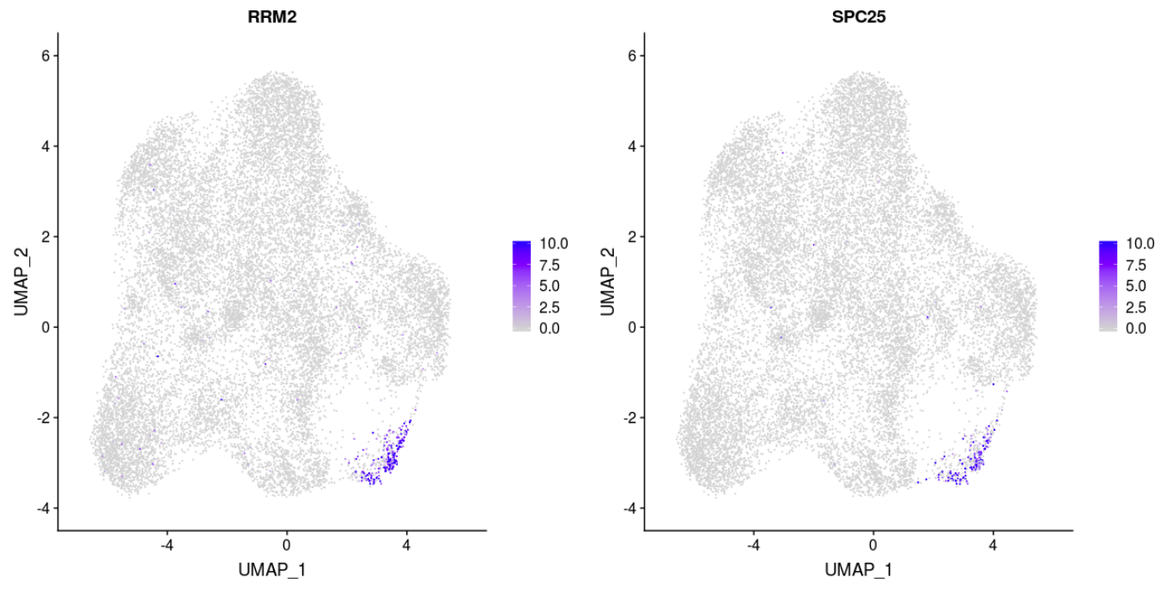
Cluster 11: RRM2, SPC25
RRM2: Provides the precursors necessary for DNA synthesis; Inhibits Wnt signaling (regulates the TSC2 tumor suppressor to negatively regulate mTor)
SPC25: Required for chromosome segregation and spindle checkpoint activity

Slide 33
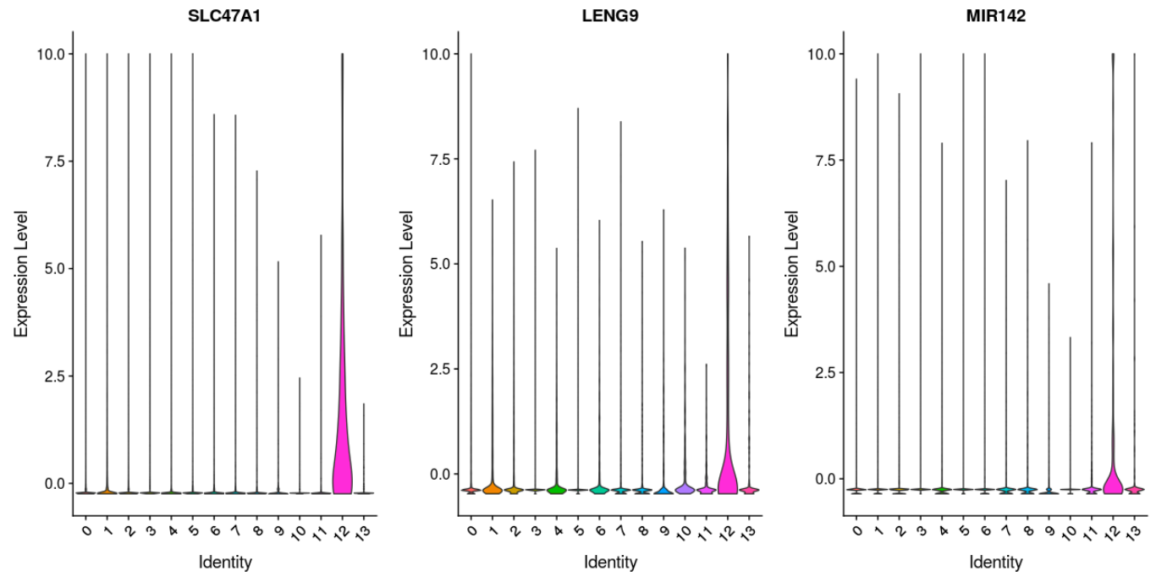
Cluster 12: SLC47A1, LENG9, MIR142

Slide 34
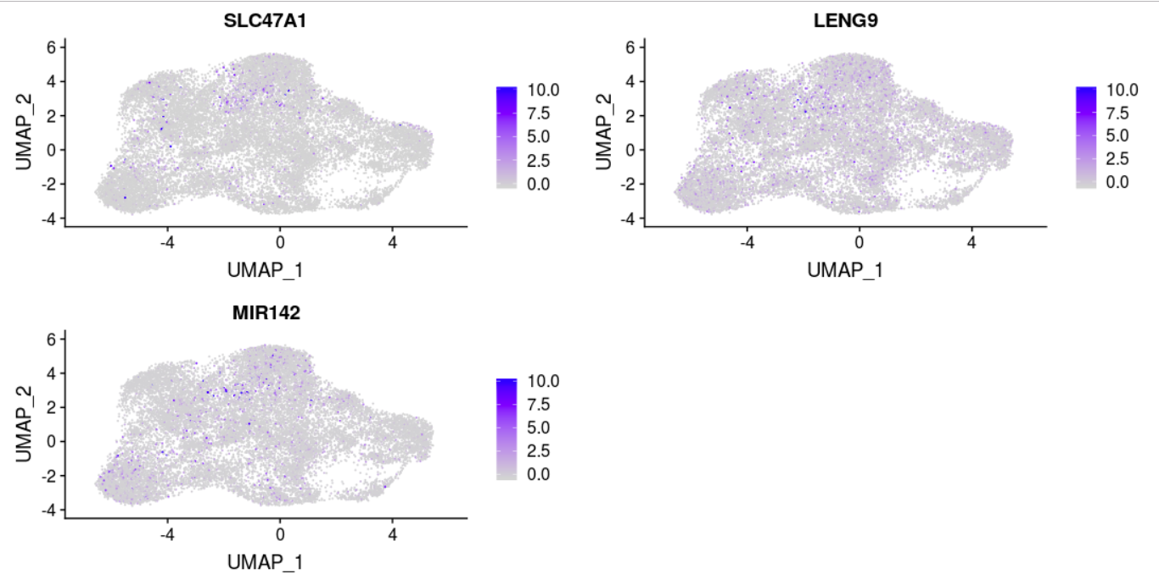
Cluster 12: SLC47A1, LENG9, MIR142
SLC37A1: translocates glucose-6-phosphate
MIR142 (miRNA): translational inhibition or destabilization of the target mRNA

Slide 35
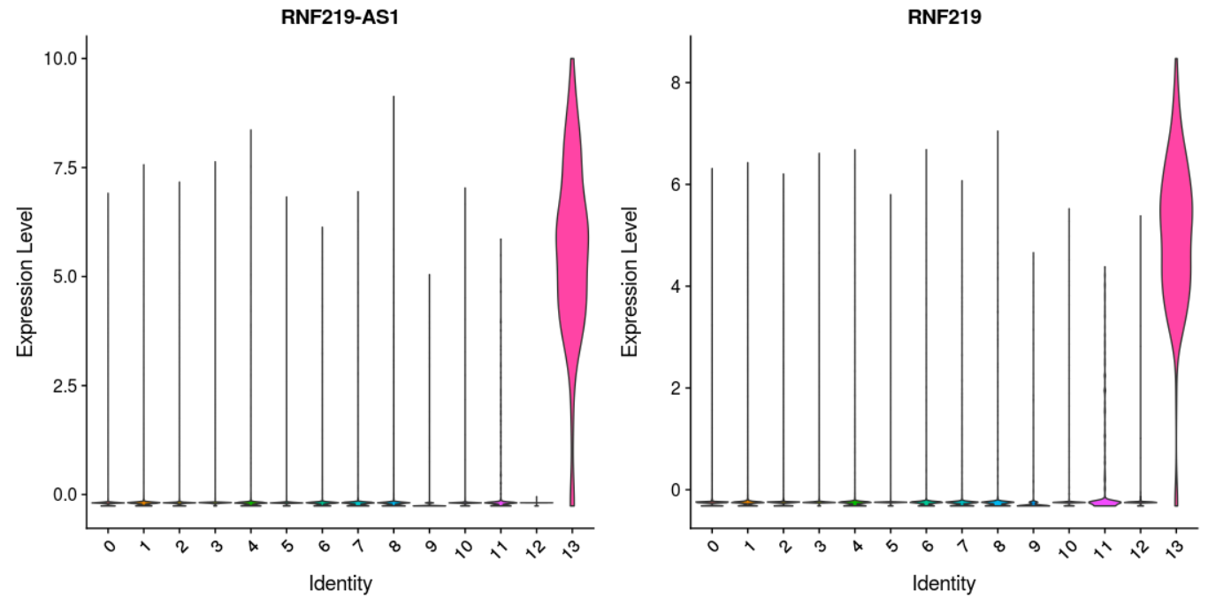
Cluster 13: RNF219-AS1, RNF219

Slide 36
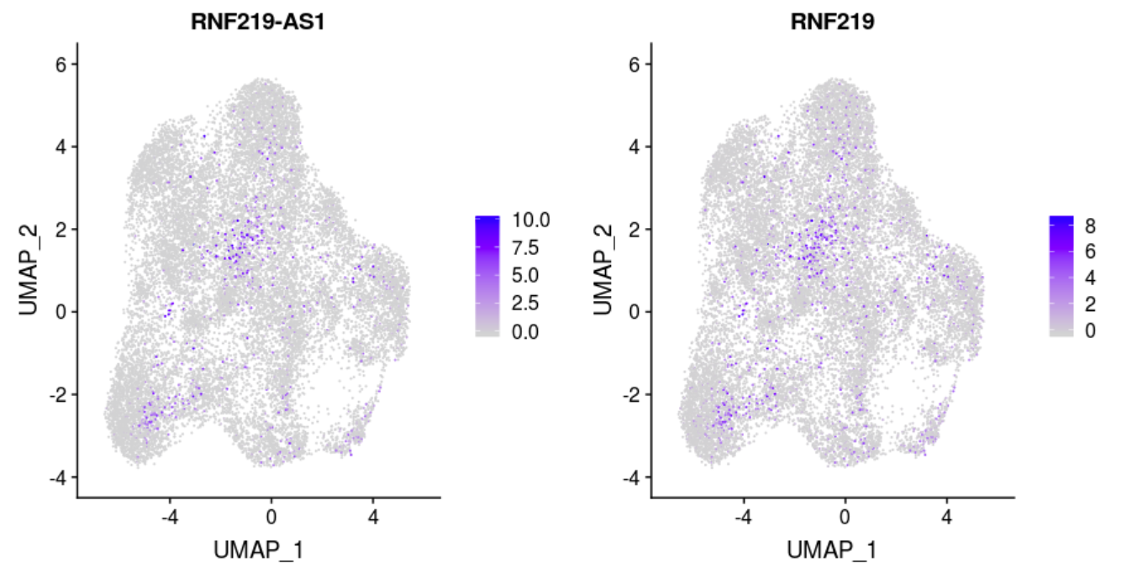
Cluster 13: RNF219-AS1, RNF219
RNF219: involved with decreased viability in human

Slide 37
Summary
Quite a few overlapping markers are found between cluster markers generated from Seurat and Conos.
Markers in each cluster define the T cell subpopulations and their functions.
Better understand tumor-infiltrating lymphocytes (TILs), and offer potential target markers for cancer therapies.

Slide 38
Acknowledgements
Alex Wenzel
Edwin Juarez
Dr. Jill Mesirov and her lab members

